Slide 1
SWINE FLU
DR.SHEREEN H.ATEF
HEAD OF INFECTION CONTROL
ALSALAMA HOSPITAL

Slide 2
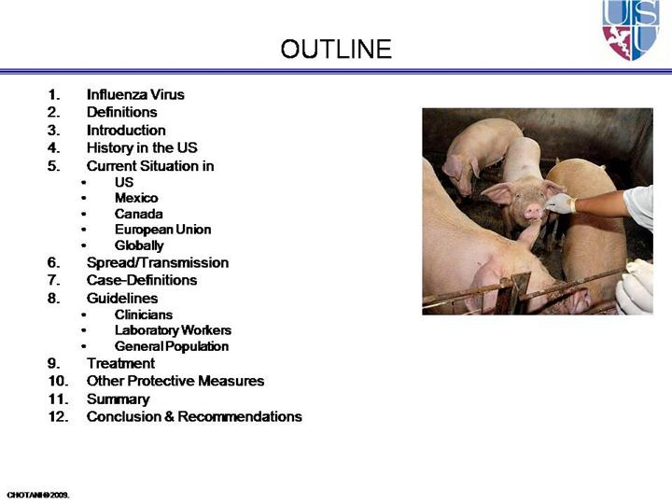

Slide 3
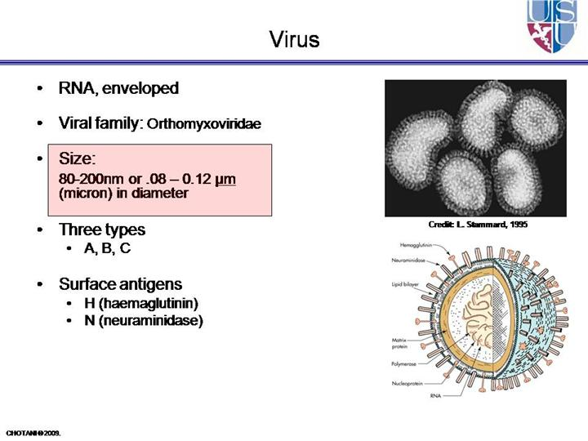

Slide 4
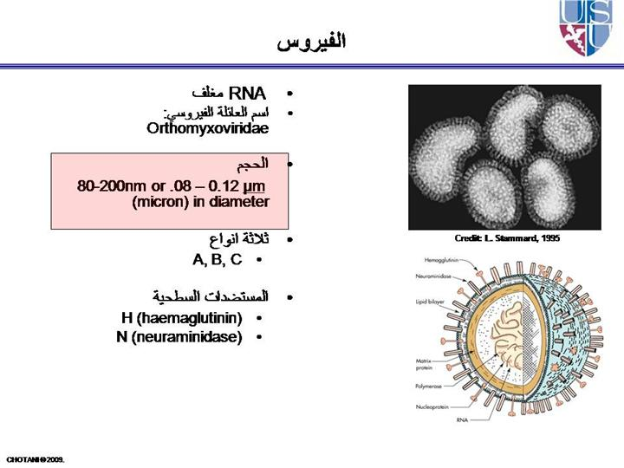

Slide 5
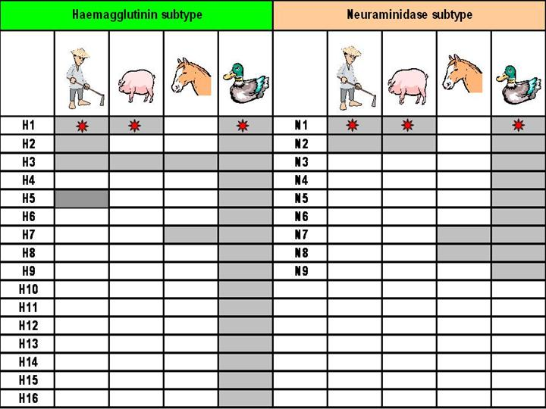

Slide 6
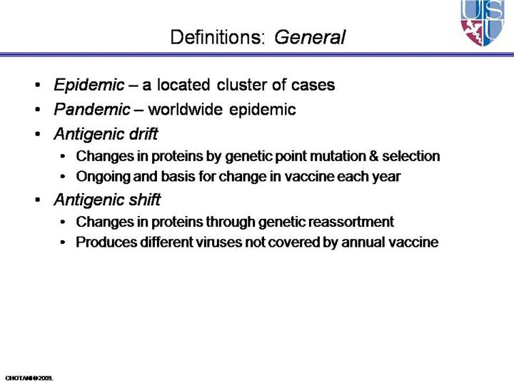

Slide 7
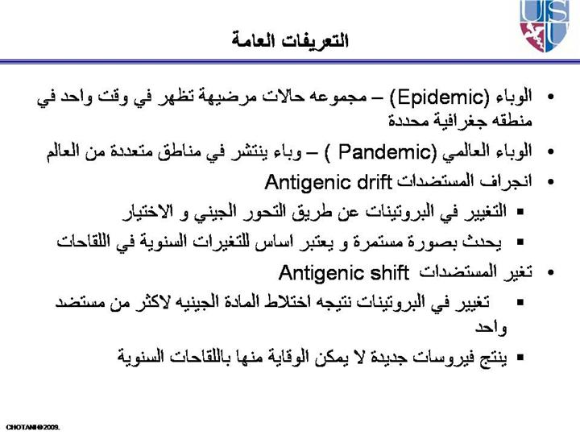

Slide 8
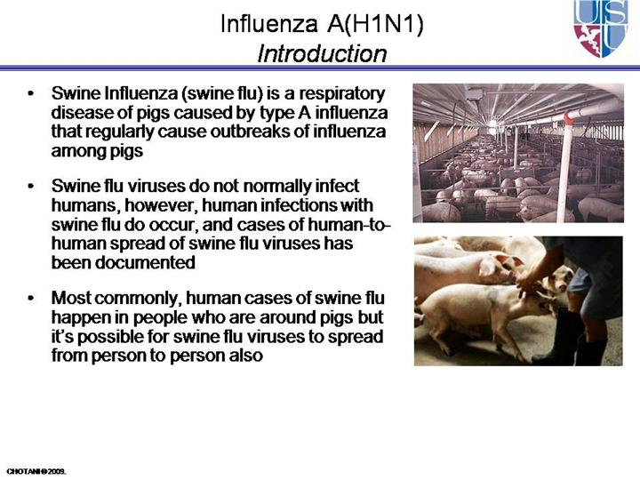

Slide 9
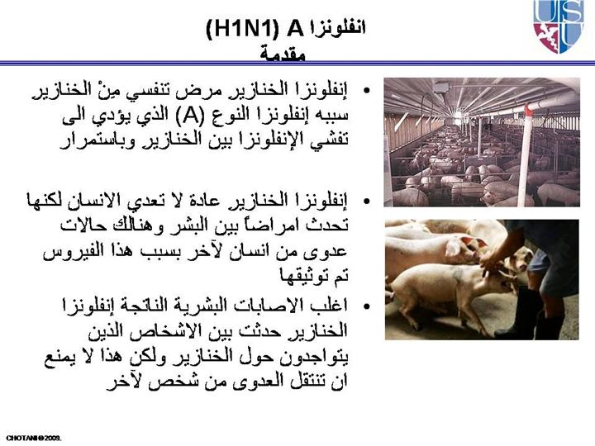

Slide 10
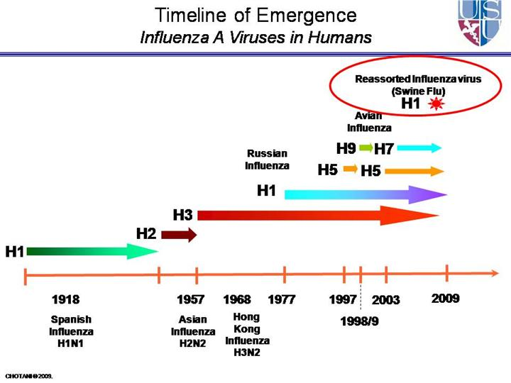
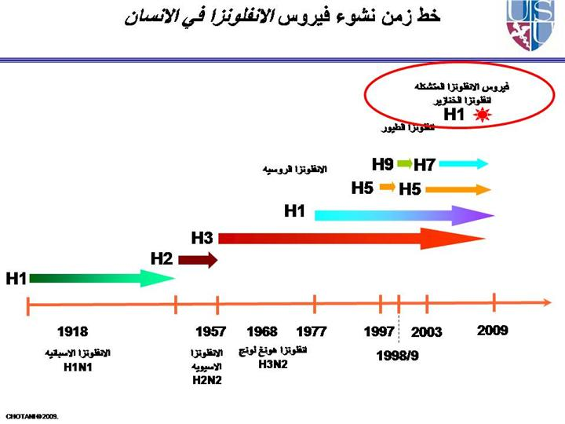

Slide 11
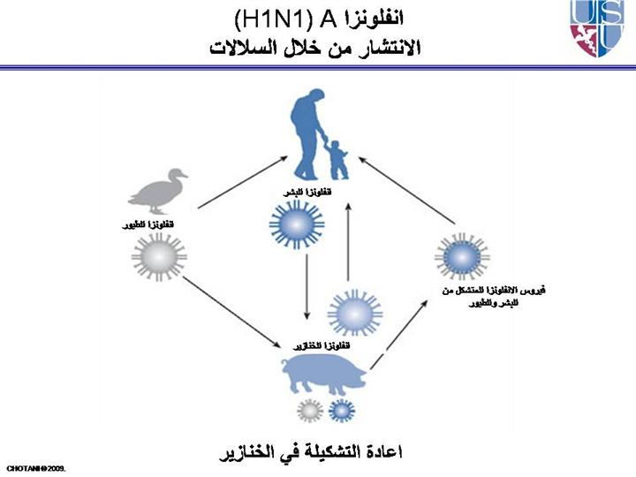

Slide 12
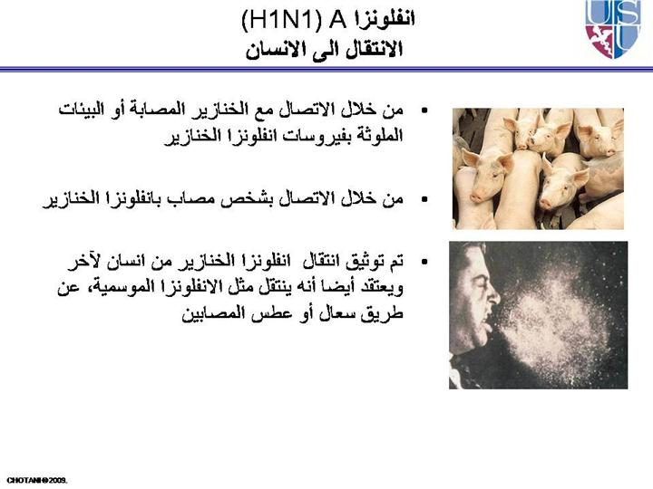

Slide 13
WHO's Pandemic Phases
The World Health Organization (WHO) provides an influenza pandemic alert system, with a scale ranging from Phase 1 (a low risk of a flu pandemic) to Phase 6 (a full-blown pandemic):
Phase 1: A virus in animals has caused no known infections in humans.
Phase 2: An animal flu virus has caused infection in humans.
Phase 3: Sporadic cases or small clusters of disease occur in humans. Human-to-human transmission, if any, is insufficient to cause community-level outbreaks.
Phase 4: The risk for a pandemic is greatly increased but not certain.
Phase 5: Spread of disease between humans is occurring in more than one country of one WHO region.
Phase 6: Community-level outbreaks are in at least one additional country in a different WHO region from phase 5. A global pandemic is under way.

Slide 14
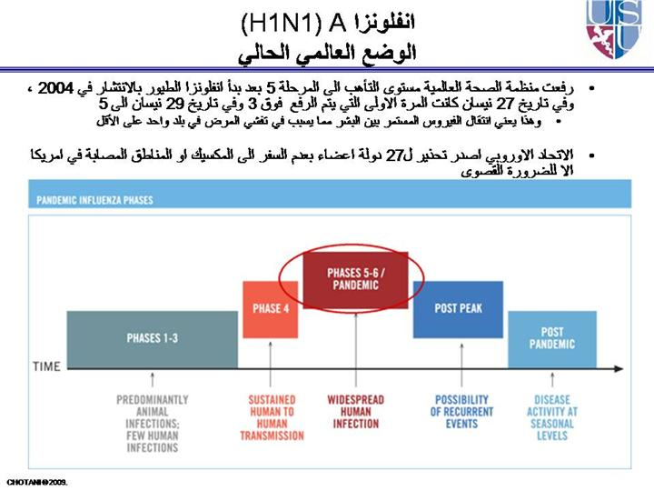

Slide 15
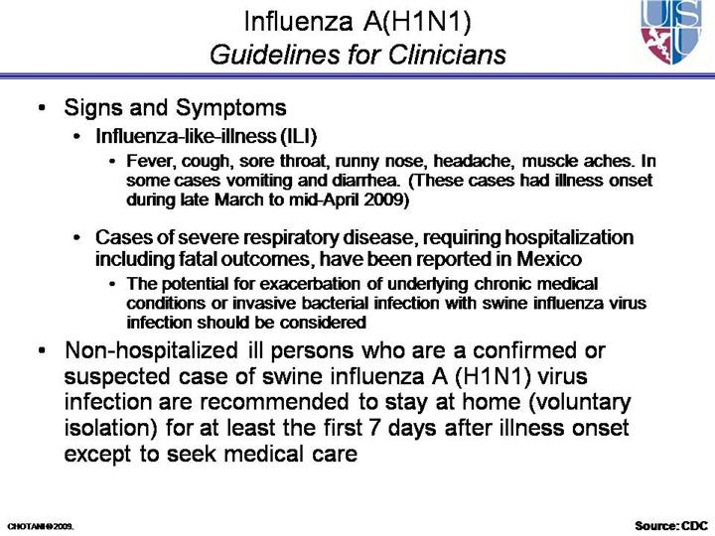

Slide 16
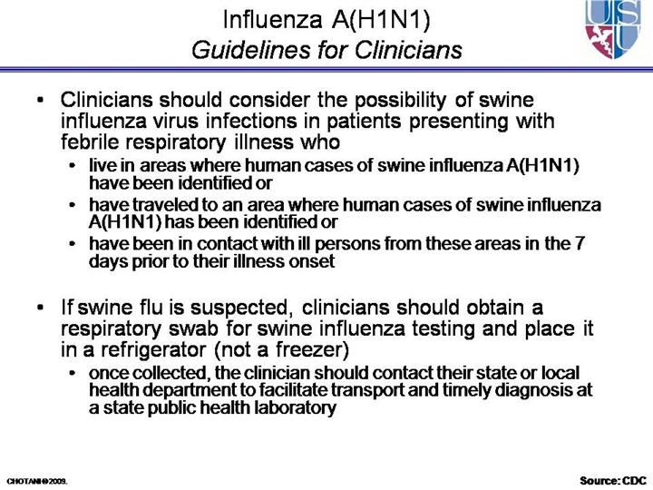

Slide 17
CRITERIA FOR SUSPECTED HUMAN CASE OF INFLUENZA‐ A(H1N1)
1. High temperature(more than 38C) AND
2. Cough or breathing difficulty AND
3. One or more of the following exposures 7 days prior to the onset of symptoms:
a) Direct contact with infected pigs or person from an infected geographical area*
b) Close contact with a person who is categorised as 3(a), that is, a suspected or probable human
case of influenza A
c) History of travel to an infected area
* An infected geographical area is a declared defined area influenza A(H1N1) has been confirmed or known to exist

Slide 18
Swine Flu Statement 30 April 2009
The World Health Organization (WHO) has raised the swine flu pandemic level from Phase 4 to Phase 5.
Phase 5 is characterised by human-to-human spread of the virus into at least two countries in the WHO region.
Although most countries in this area are not affected at this stage, Phase 5 indicates that the pandemic is imminent and organisation, communication and implementation measures are in place to manage the situation should it change.
HAAD continues to monitor the H1N1 outbreak through its 24-hour Incident Command Centre.
HAAD has an Incident Response Plan in place involving Public Health, and is tracking the swine flu outbreak by the hour.

Slide 19
There have been no recorded cases in Abu Dhabi and there are enough stores of antivirals in place, and a plan pathway, should the need arise.
HAAD adopts the standard precautions as advised by the WHO and the advice is for anyone travelling from the affected areas to seek medical help if flu symptoms develop.
Hospitals and health facilities are on high alert for people presenting with flu-like symptoms.

Slide 20
PROCESS TO MANAGE A SUSPECTED HUMAN CASE OF Swine INFLUENZA
Event | Action | Person responsible
1. Patient arrives at healthcare facility | 1. Take vital signs and temperature 2. Screening question • Travel history in last 7 days • cough | Nurse Nurse

Slide 21
Event | Action | Person responsible
2. Doctor suspected influenza A(H1N1) based on criteria for suspected human case of swine flu | 1. Isolate the patient 2. Take standard infection control precautions 3. Take posterior pharyngeal throat swab 4. Call infection control team 5. Call pathologist at SKMC (on call) to discuss lab sample and transport requirements for samples (02‐6102000) 6. Call infectious diseases consultant in regional receiver hospital to report suspected case 7. Fill case report form and fax it to CDC immediately Abu Dhabi fax to: 02 4496966 | Nurse Nurse /Doctor Nurse/ Doctor Attending doctor Attending doctor Attending doctor Attending doctor

Slide 22
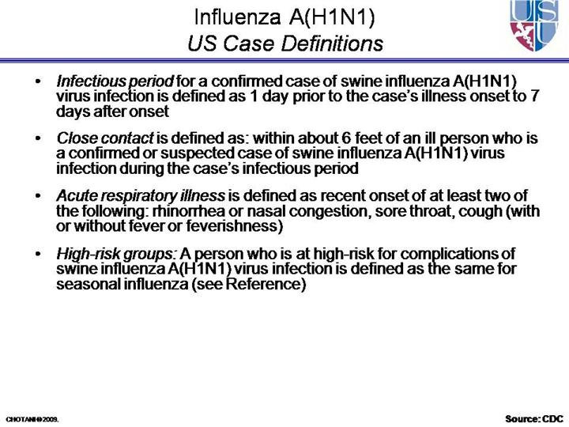

Slide 23
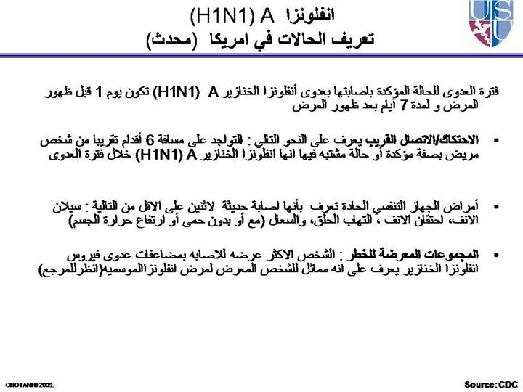

Slide 24
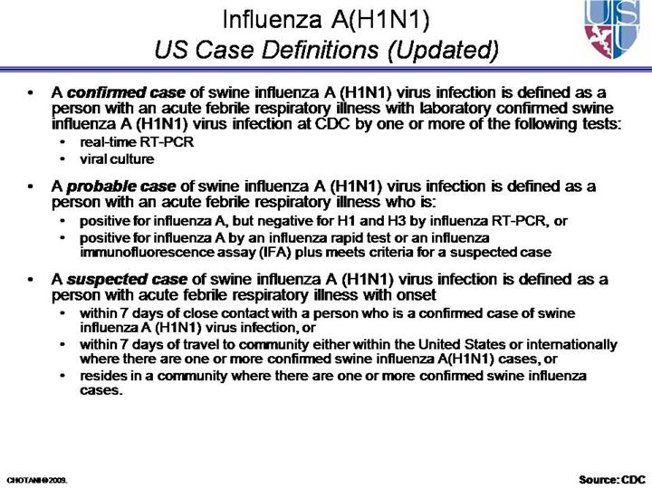

Slide 25
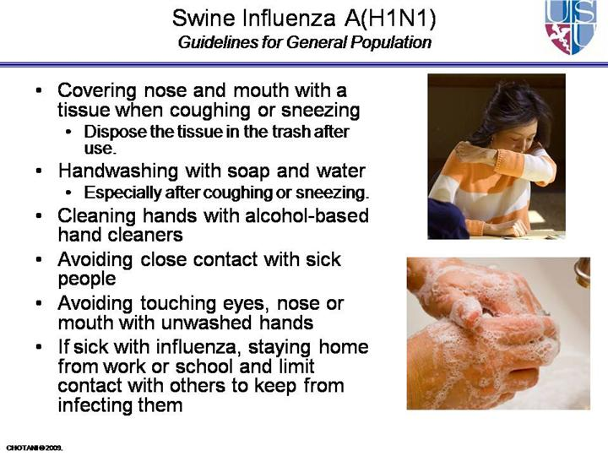

Slide 26
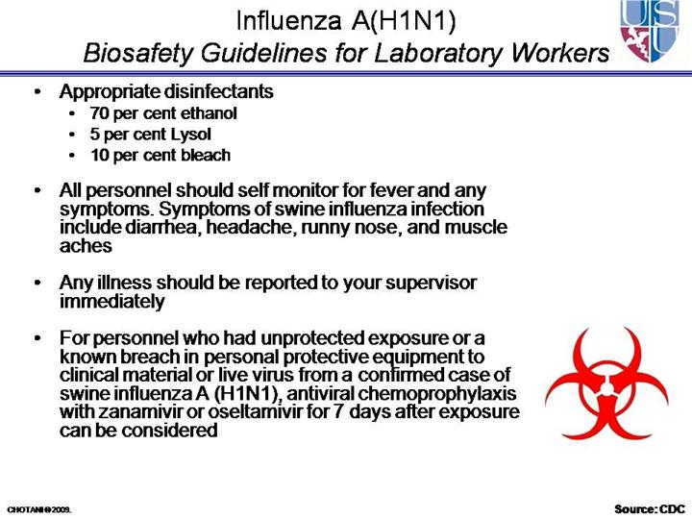

Slide 27
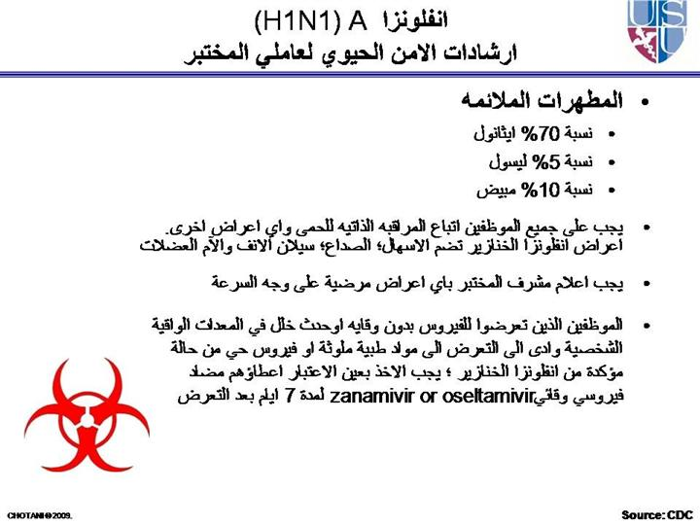

Slide 28
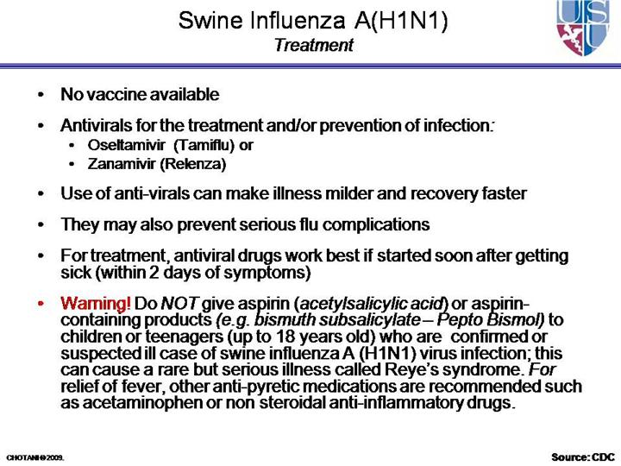

Slide 29
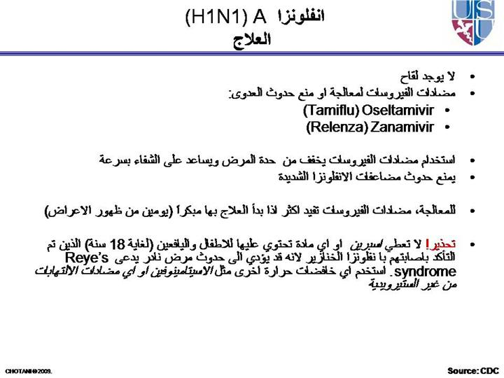

Slide 30
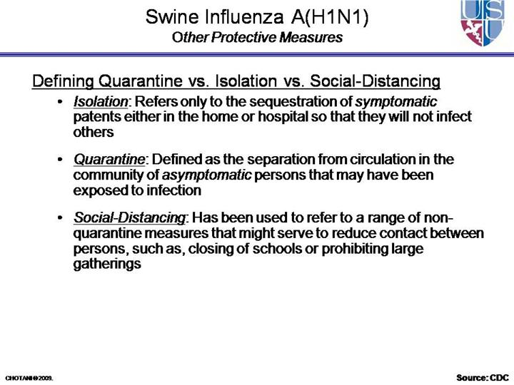

Slide 31
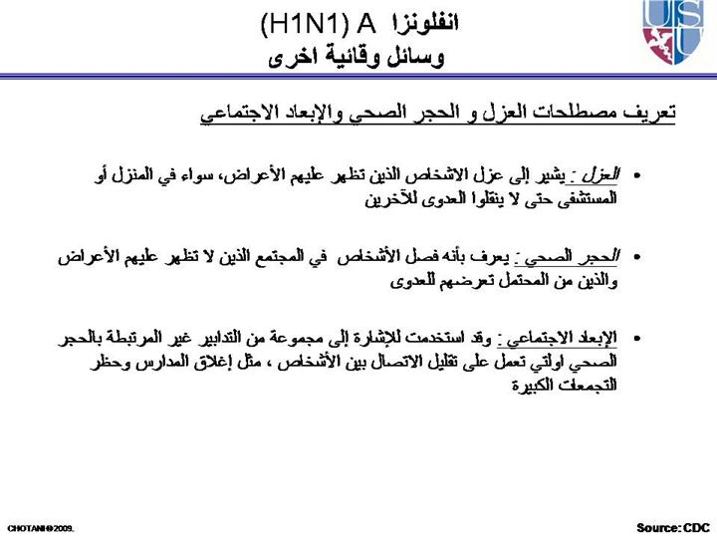

Slide 32
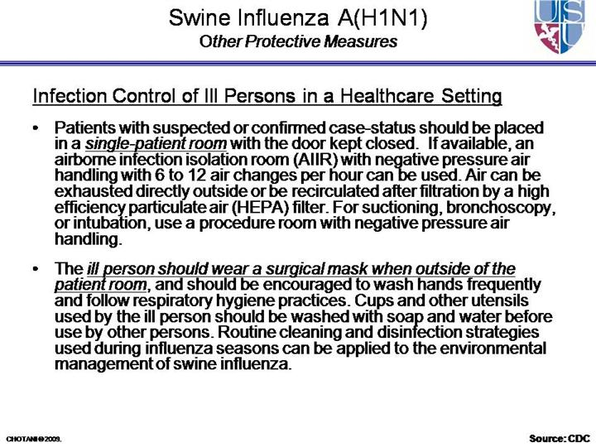

Slide 33
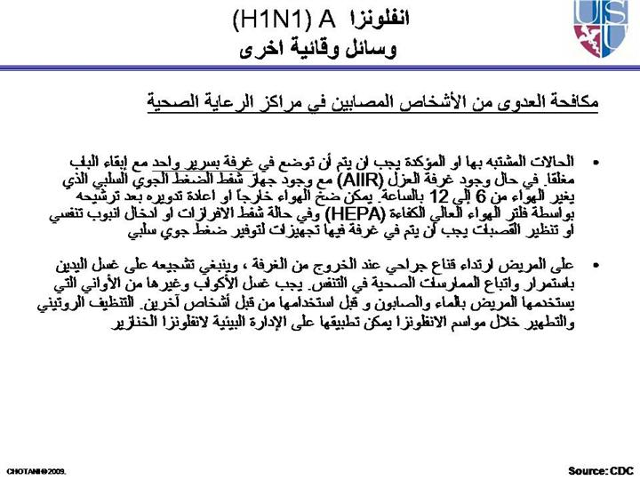

Slide 34
THANK YOU
For Any Information
Dr. Shereen H.Atef Ext 1109
Cell phone 0509723220

